Slide 1
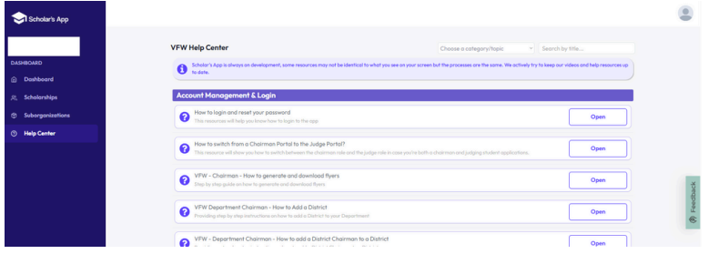
HOW TO SWITCH FROM CHAIRMAN TO JUDGE
IF YOU ARE A CHAIRMAN AND A JUDGE, TO SWITCH VIEWS, CLICK ON THE GRAY SILHOUETTE ICON LOCATED IN THE UPPER RIGHT-HAND CORNER OF THE SCREEN.

Slide 2
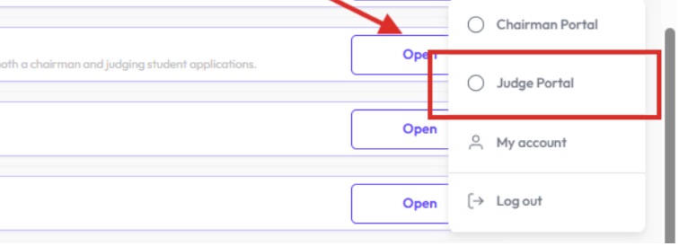
HOW TO SWITCH FROM CHAIRMAN TO JUDGE
CLICK ON “JUDGE PORTAL”, ONCE YOU SUCCESSFULLY COMPLETED THESE STEPS, YOU WILL NO LONGER SEE THE VERTICAL BLUE BAR. REMEMBER YOU HAVE TO BE ADDED AS A “JUDGE” TO ACCESS THE PORTAL.

Slide 3
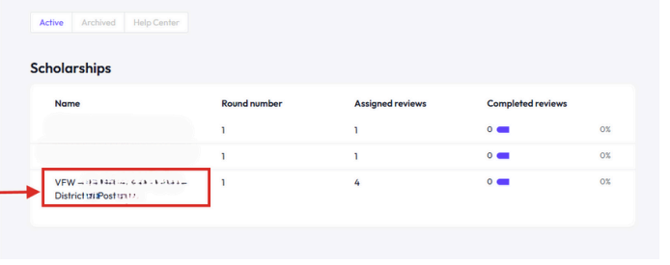
JUDGES
How to Review & Score Applications
STEP 1: GO TO HTTPS://APP.SCHOLARSAPP.COM AND LOG IN USING THE SAME EMAIL WHEN YOU RECEIVED THE JUDGE INVITATION. THAT EMAIL ALLOWS YOU TO ACCESS THE APPLICATIONS FOR REVIEW.
STEP 2: AFTER YOU LOG IN, YOU WILL SEE THE NAME OF THE SCHOLARSHIP(S) ASSIGNED TO YOU. CLICK ON THE NAME OF THE SCHOLARSHIP YOU ARE JUDGING. VOD or PP
VFW – Patriots Pen - Minnesota

Slide 4
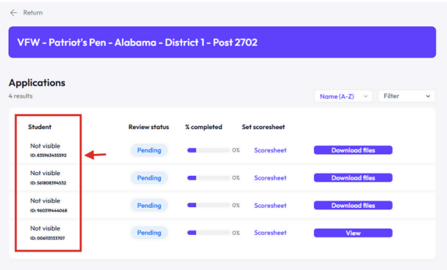
STEP 3. AFTER YOU CLICK ON SCHOLARSHIP NAME, YOU WILL SEE A LIST OF STUDENT APPLICATIONS.
STUDENT NAME – YOU WILL NOT SEE THE STUDENT’S NAME, BUT AN ID # AND THE WORD “NOT VISIBLE”. THIS KEEPS JUDING THE APPLICANT FAIRLY AND NO BIAS.

Slide 5
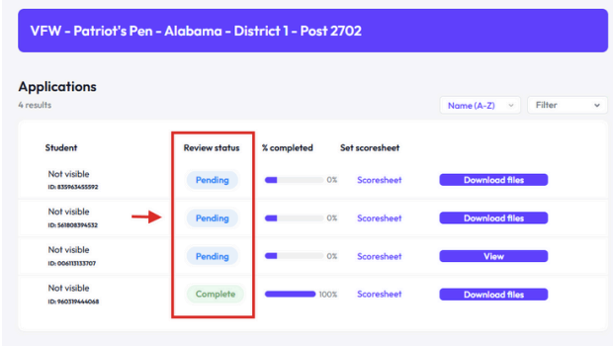
STEP 4. IF YOU HAVEN’T SCORED THE APPLICATION YET, IT WILL SHOW AS “PENDING”. AFTER YOU SCORE THE APPLICATION AND SAVE IT, “PENDING” WILL CHANGE TO “COMPLETE”

Slide 6
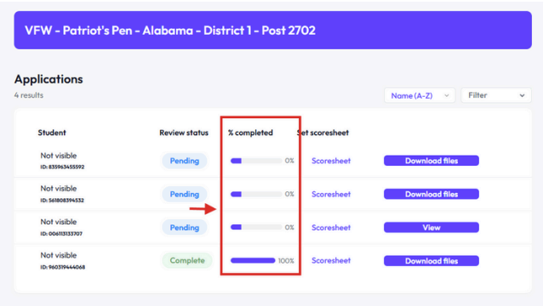
STEP 5. YOU CAN TRACK YOUR PROGRESS OF ASSIGNED APPLICATIONS YOU HAVE REVIEWED UNTIL COMPLETED.
STEP 6. CLICK ON SCORESHEET. HERE YOU WILL SEE JUDGING INSTRUCTIONS AND CRITERIA. ENTER YOUR SCORES FOR EACH SECTION FOR EACH APPLICATION.

Slide 7
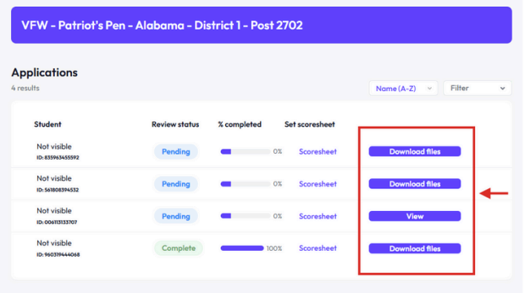
STEP 7: THE “VIEW” BUTTON MEANS THE STUDENT APPLIED DIRECTLY TO
SCHOLARSAPP.
STEP 8: THE “DOWNLOAD” BUTTON MEANS THE APPLICATION WAS
UPLOADED MANUALLY BY YOUR CHAIRMAN.

Slide 8
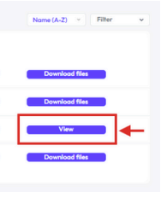
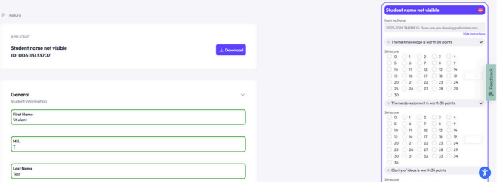
STEP 9: OPEN THE APPLICATION IF YOU SEE “VIEW” BUTTON. CLICK ON “VIEW” TO OPEN THE STUDENT’S APPLICATION IN A NEW TAB
IF OPENED CORRECTLY THE PAGE SHOULD LOOK LIKE
THE TWO PICTURES BELOW.

Slide 9
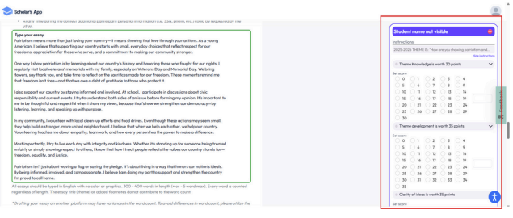
STEP 10. SCROLL DOWN TO READ THE STUDENT’S ESSAY.
STEP 11. AS YOU SCROLL AND READ THE ESSAY, YOU WILL SEE THE SCORESHEET ON THE RIGHT-HAND SIDE. YOU CAN START SCORING WHILE READING, NO NEED TO SWITCH TABS.

Slide 10
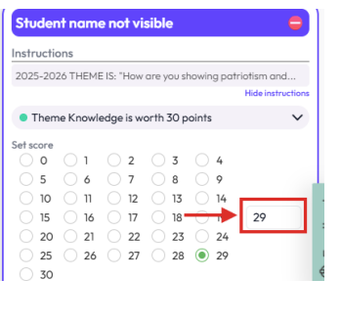
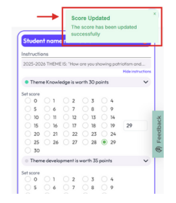
STEP 12. CLICK THE CIRCLE NEXT TO THE NUMBER YOU WANT TO
GIVE TO THE STUDENT. THE NUMBER YOU SELECTED WILL
APPEAR IN A SMALL BOX ON THE SIDE.
YOU WILL SEE A GREEN CONFIRMATION MESSAGE AT THE TOP. THIS MEANS YOUR SCORE WAS SAVED

Slide 11
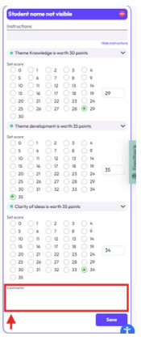
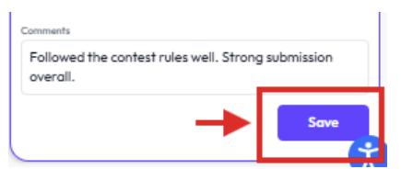
STEP 13. DO THIS FOR EACH SCORING SECTION. AFTER SCORING, TYPE YOUR COMMENTS IN THE COMMENT BOX.
STEP 14. CLICK “SAVE”

Slide 12
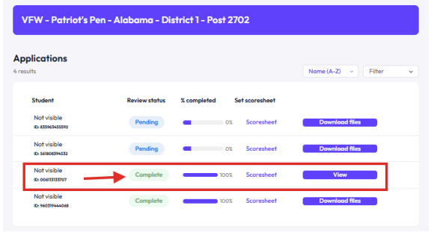
STEP 15. ONCE YOU CLICK “SAVE”, GO BACK TO THE “JUDGEMENT ROUNDS TAB/APPLICATIONS AND YOU WILL SEE THAT THE APPLICATION YOU JUST SCORED IS NOW MARKED AS “COMPLETE”
NOW MOVE ON AND REVIEW THE NEXT APPLICATION

Slide 13
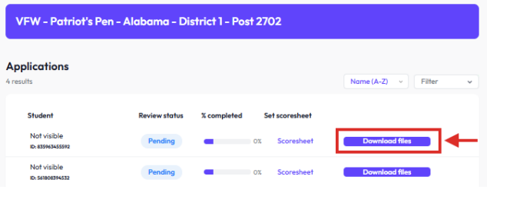
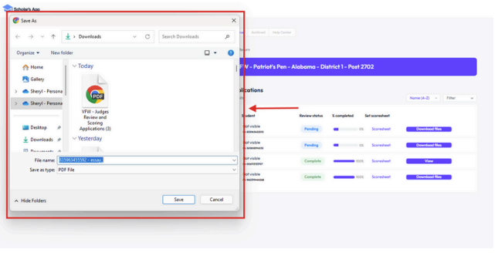
STEP 16. CLICK THE “DOWNLOAD” BUTTON TO GET THE STUDENT’S
ESSAY.
STEP 17. A POP-UP WINDOW WILL SHOW UP, SAVE FILE TO YOUR
COMPUTER. CHANGE FILE NAME IF YOU WANT AND CLICK SAVE.

Slide 14
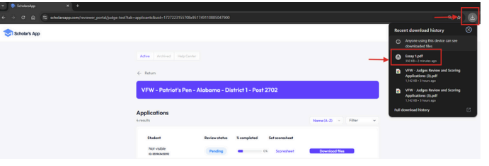
STEP 18. GO TO YOUR “DOWNLOAD FILES” BUTTON AND CLICK THE FILE
TO OPEN. OR CLICK THE DOWNLOAD ICON AT THE TOP
RIGHT OF YOUR BROWSER (USUALLY A SMALL ARROW) TO
QUICKLY OPEN THE ESSAY YOU JUST SAVED.

Slide 15
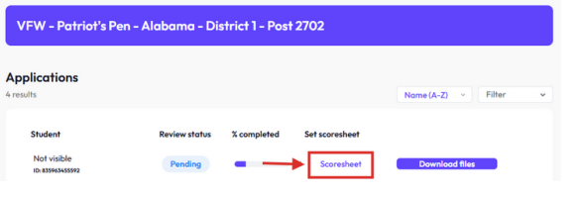
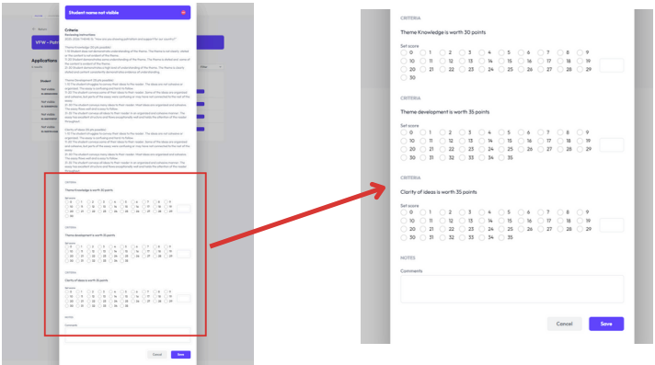
STEP 19. YOU READ THE ESSAY. RETURN TO APPLICATIONS TAB
AND CLICK “SCORESHEET” TO BEGIN SCORING.
STEP 20. YOU WILL SEE THE CRITERIA AND REVIEWING INSTRUCTIONS. SCROLL DOWN TO ENTER YOUR SCORE

Slide 16
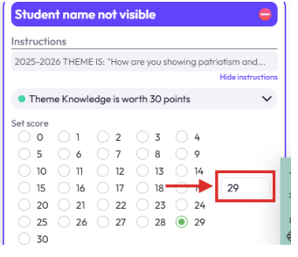
STEP 21. CLICK THE CIRCLE NEXT TO THE NUMBER YOU WANT TO GIVE THE
STUDENT. THE NUMBER YOU SELECT WILL APPEAR IN A SMALL BOX
ON THE SIDE. GREEN CONFIRMATION MESSAGE MEANS YOUR
SCORE WAS SAVED.

Slide 17
STEP 21. DO THIS FOR EACH SCORING SECTION. AFTER SCORING,
TYPE YOUR COMMENT IN THE COMMENTS BOX. CLICK ON
“SAVE” BUTTON.
STEP 22. ONCE SAVED, GO BACK TO APPLICATIONS TAB AND THE
APPLICATION YOU JUST SCORED IS NOW MARKED AS “COMPLETE”

Slide 18
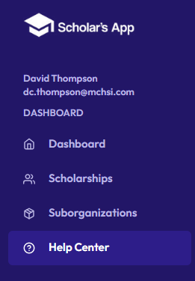
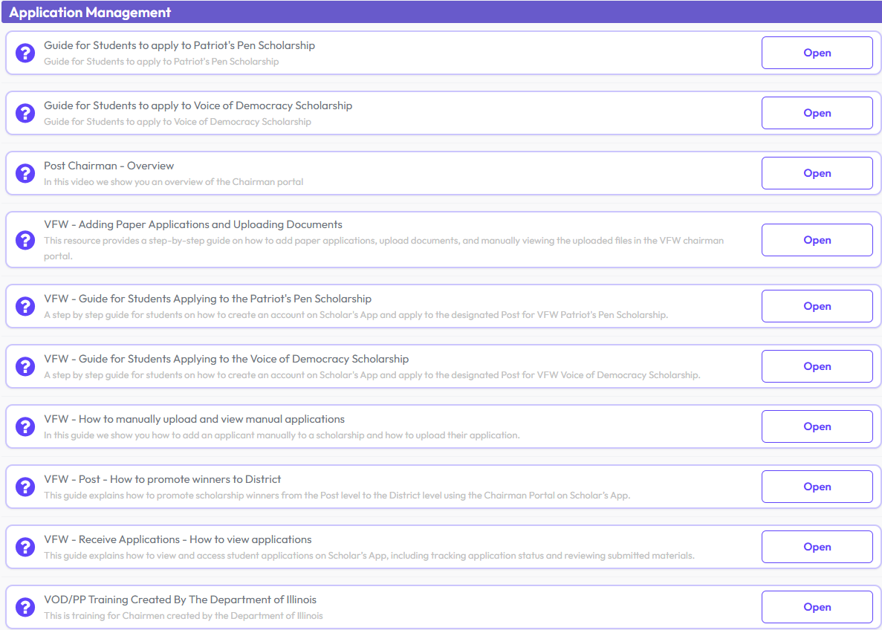

More Questions? Consult Help Center Tab

Slide 19
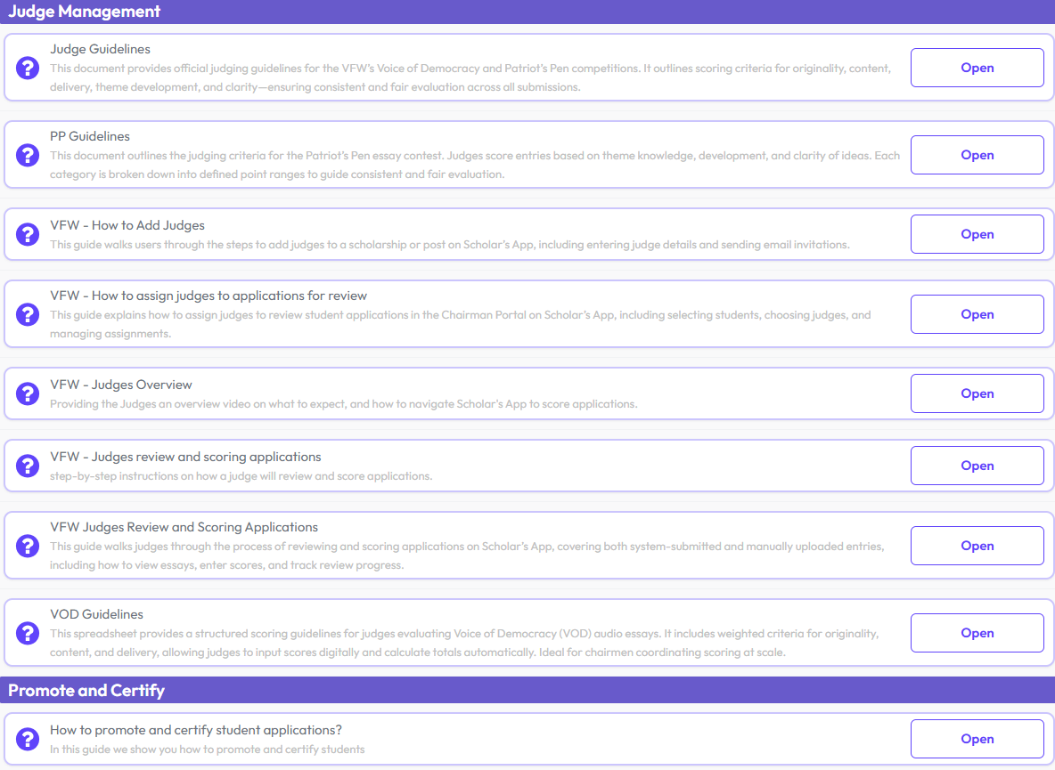
More Questions? Consult Help Center Tab

Slide 20
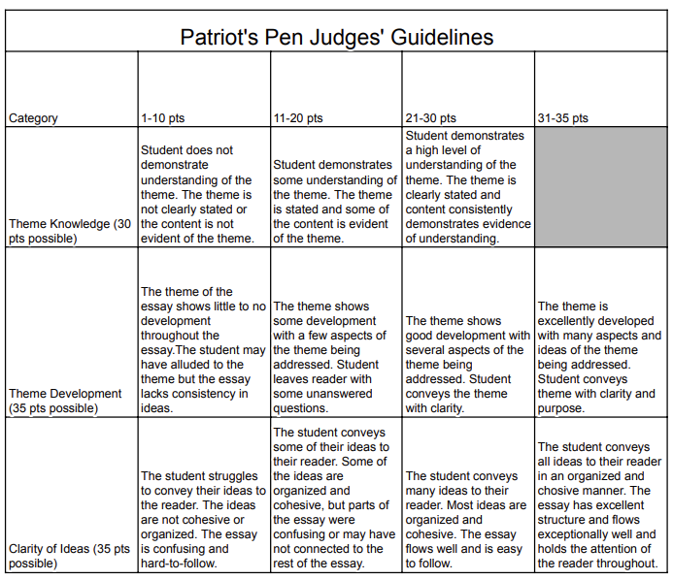

Slide 21
