Slide 1
Scholars App
Post VOD/PP Chairs from last year can use their same username and password.
For new Post Chairs, the State VOD/PP Chair will create an account for first time users of this App. Send your First and Last Name & email address to the State Chair to be uploaded to the App.
The new Post Chair will receive an email from Scholars App to log in and set up your profile (check spam folder) with a temporary password that will expire within 24 hrs.
Log into ScholarsApp with temp password. If temp password does not work, click on “Forgot My Password”. Once you are in the App you can change the password to something that you can remember in the future.

Slide 2
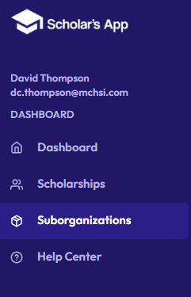
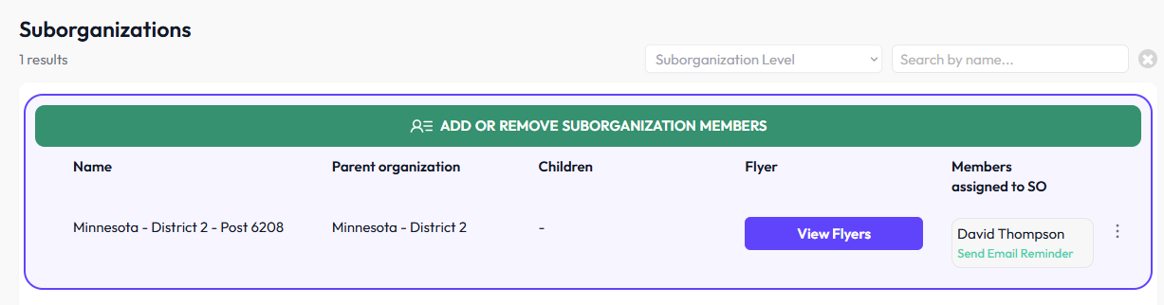
How to Download Flyers
1. GO TO THE TAB “SUBORGANIZATIONS
2. CLICK ON “VIEW FLYERS”
3. CLICK ON “DOWNLOAD FLYERS” AND SAVE ON
YOUR COMPUTER
4. CHECK TO MAKE SURE QR CODE WORKS.

Slide 3
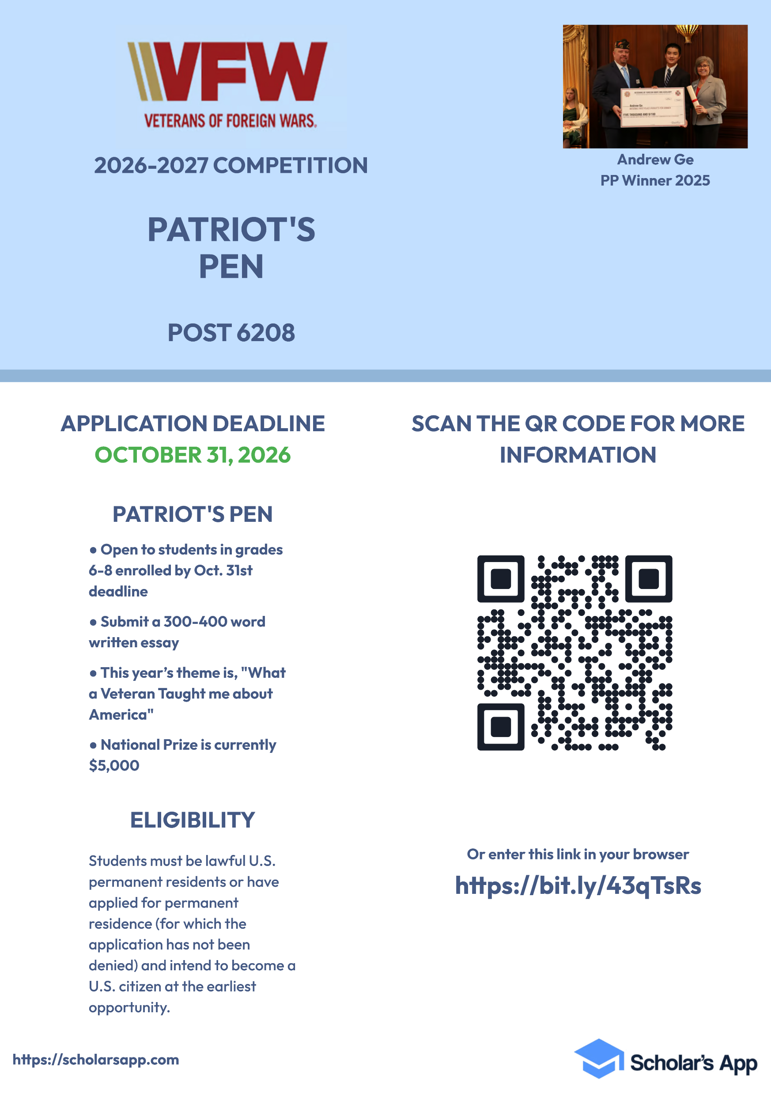


Slide 4
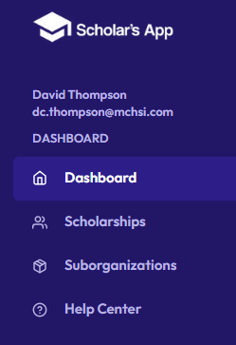
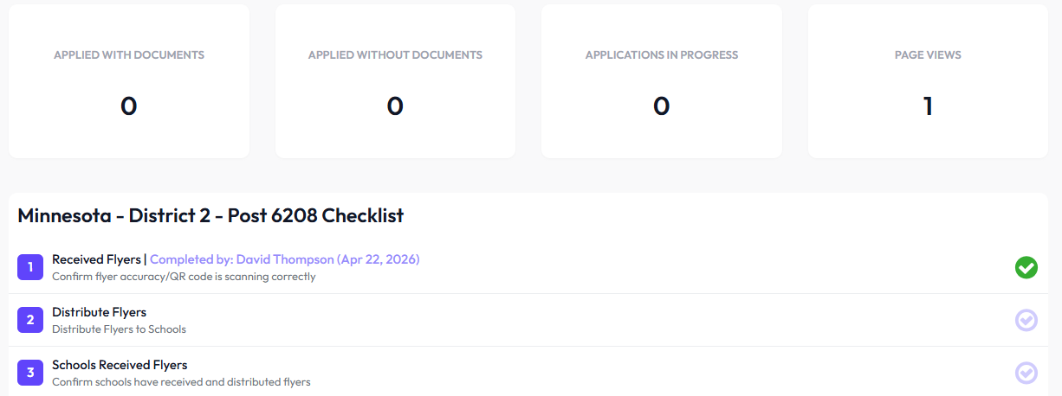
USE CHECKLIST, IT’S A HELPFUL TOOL
CLICK ON “DASHBOARD” IN THE BLUE TAB BOX
2. CLICK ON THE “BLUE CHECK MARK” TO SHOW THAT
YOU HAVE DOWNLOADED AND VERIFIED THE FLYERS. THIS
CHECKLIST WILL HELP AS YOU CONTINUE WITH THE
PROCESS.

Slide 5
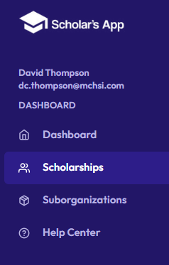
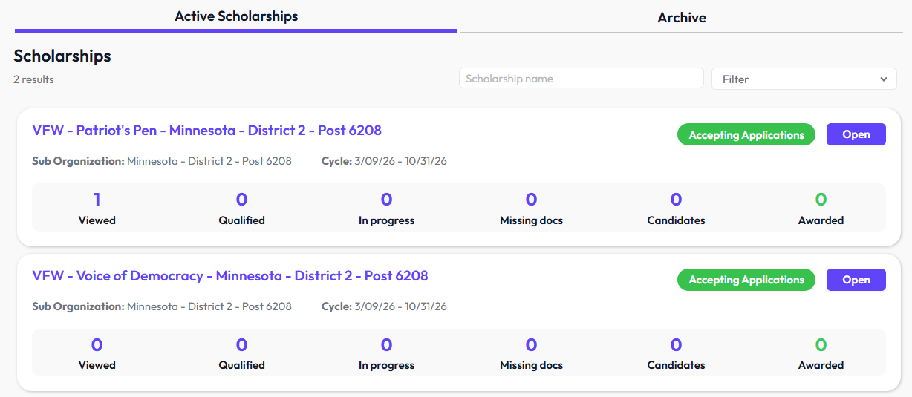
HOW TO MANUALLY UPLOAD & VIEW APPLICATIONS
1. CLICK THE “SCHOLARSHIPS” TAB
2. VFW POST VOD AND PP WILL SHOW UP.
3. CLICK ON “OPEN”

Slide 6
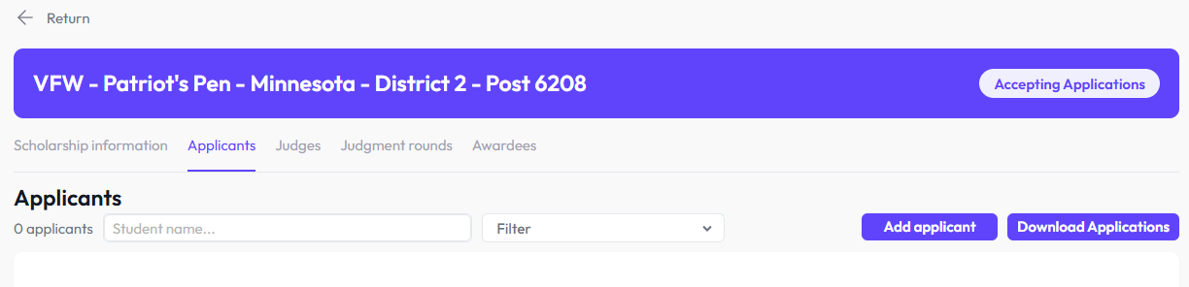
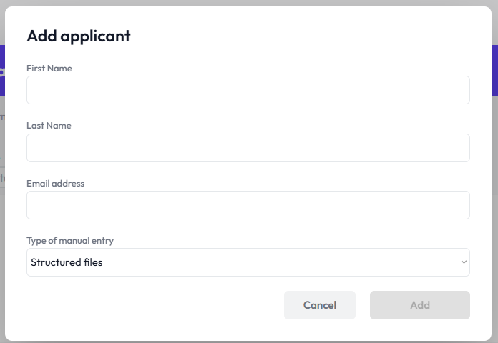
4. CLICK ON “APPLICANTS” TAB
5. CLICK ON “ADD APPLICANT” BUTTON
Add
6. ENTER THE STUDENT’S FIRST & LAST NAME & EMAIL. SELECT
“TYPE OF MANUAL ENTRY” AND SELECT “STRUCTURED FILES”.
THE “ADD” BUTTON WILL TURN BLUE, CLICK ON “ADD”

Slide 7
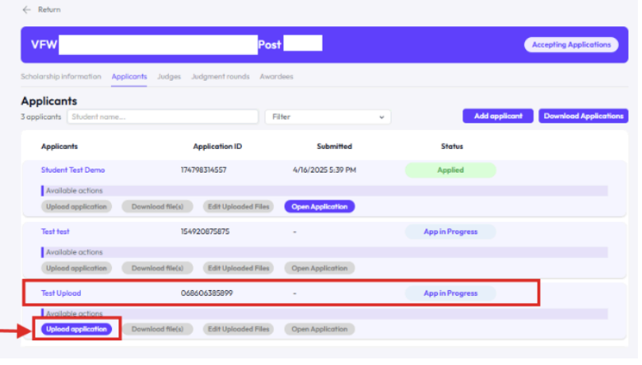
7. ONCE ADDED, THE STUDENT WILL APPEAR IN THE APPLICANT LIST AS “APP IN PROGRESS”. FIND THEIR NAME AND CLICK ON “UPLOAD APPLICATION.

Slide 8
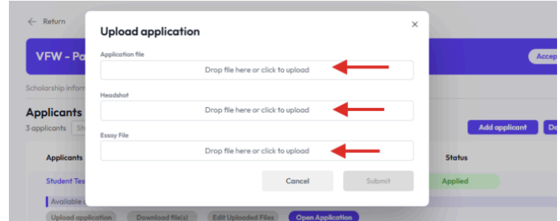
8. THREE FILES (4 IF VOD) WILL NEED TO BE SCANNED AND
UPLOADED TO YOUR COMPUTER.
APPLICATION FORM
HEADSHOT
ESSAY FILE
AUDIO FILE (FOR VOD ONLY)
CLICK ON THE “DROP FILE HERE OR CLICK TO UPLOAD BUTTON” TO UPLOAD EACH ONE. UPLOAD ALL FILES FROM YOUR COMPUTER AND CLICK ON “SUBMIT” BUTTON
Submit

Slide 9
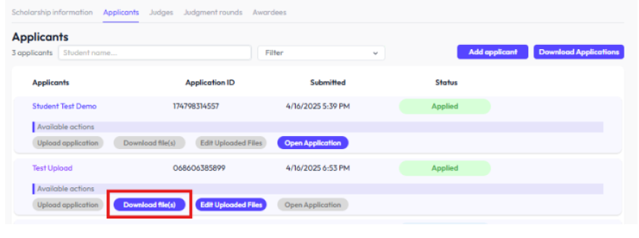
9. The Application has been uploaded and ready to view. Click on “Download Files” under applicant’s name/application ID.
10. To View the Application without downloading files Click on Open
Application.
11. The “Save As” window will pop-up and you can download files and
choose a folder on your computer to save the files, then click “Save”

Slide 10
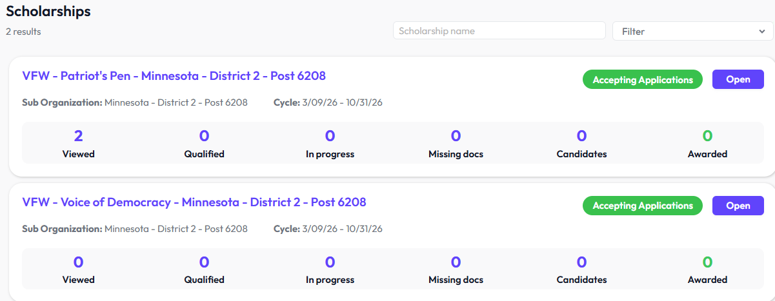
HOW TO PROMOTE VOD/PP WINNERS TO DISTRICT
CLICK ON SCOLARSHIPS TAB
CLICK EITHER PATRIOTS PEN OR VOICE OF DEMOCRACY TO
OPEN IT.
Click Here
OR
Click Here

Slide 11
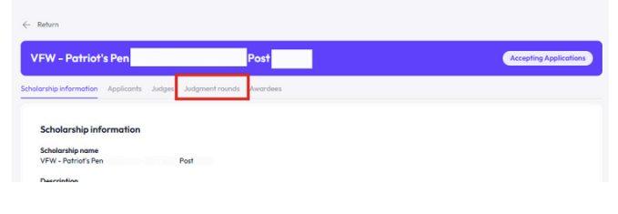
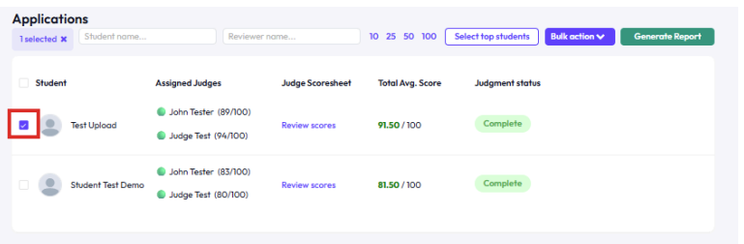
3. Click on “Judgment Rounds” Tab
4. Click on the Check box next to EACH student you want to promote to District. The
box will turn purple once selected. 15:1 Ratio applies. One winner for every 15 entries

Slide 12
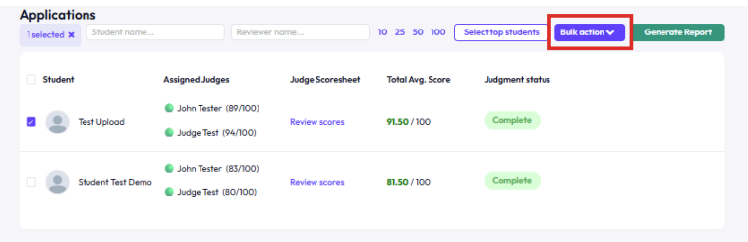
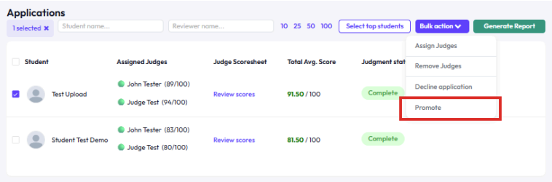
5. After Selecting the Student(s). Click on “Bulk Action” Button.
6. CLICK PROMOTE

Slide 13
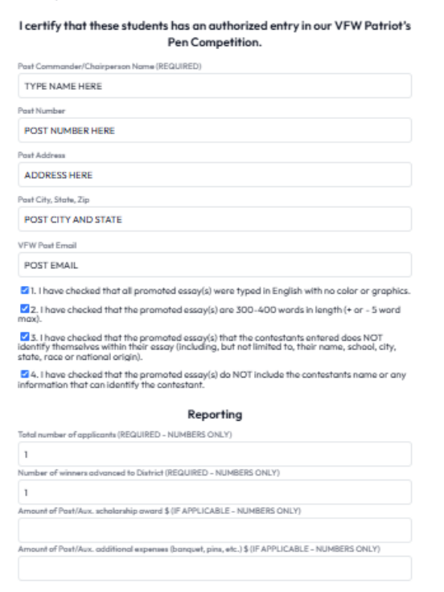
7. CAREFULLY FILL IN
CERTIFICATION DETAILS

Slide 14
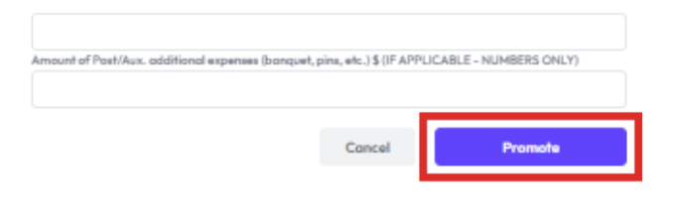
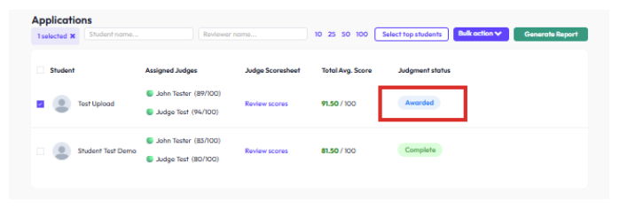
8. Click “Promote” to Submit to District
9. The Student’s Judgment Status will change to “Awarded” confirming the application process has been selected and promoted successfully.

Slide 15
HOW TO ADD JUDGES
CLICK ON SCOLARSHIPS TAB
CLICK EITHER PATRIOTS PEN OR VOICE OF DEMOCRACY TO
OPEN IT.
Click Here
OR
Click Here

Slide 16
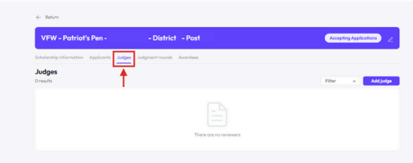
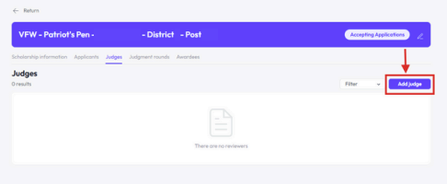
3. Click on “JUDGES” Tab
4. Click on “Add Judge” Button

Slide 17
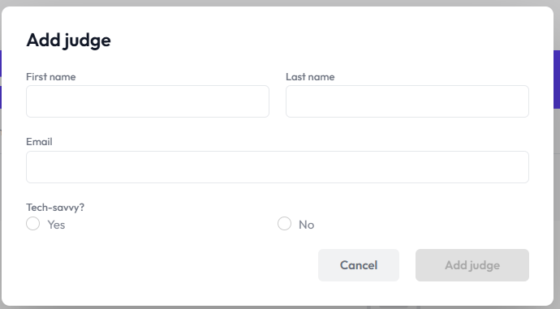
5. Carefully fill in the information. Make sure email address is spelled
correctly or the Judge will not receive the invite to be a Judge.
6. Please select “Yes” or “No” if the person is comfortable with
technology. Best to know this before assigning them to be a judge.

Slide 18
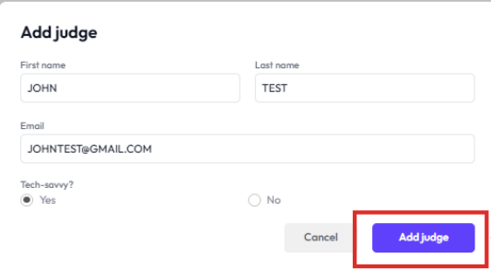
7. Once you have completed the form, the “Add Judge”
button will turn blue. Click on “Add Judge”

Slide 19
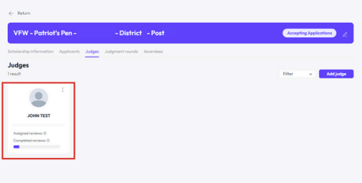
8. Once the Judge has been added, the name will appear. Click on
Add Judge to Repeat Steps to add all participating Judge(s) to that
particular Scholarship & Post.
9. Each Invited Judge will receive an email with instructions to
log in and activate their account.

Slide 20
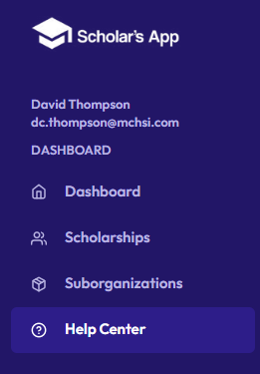
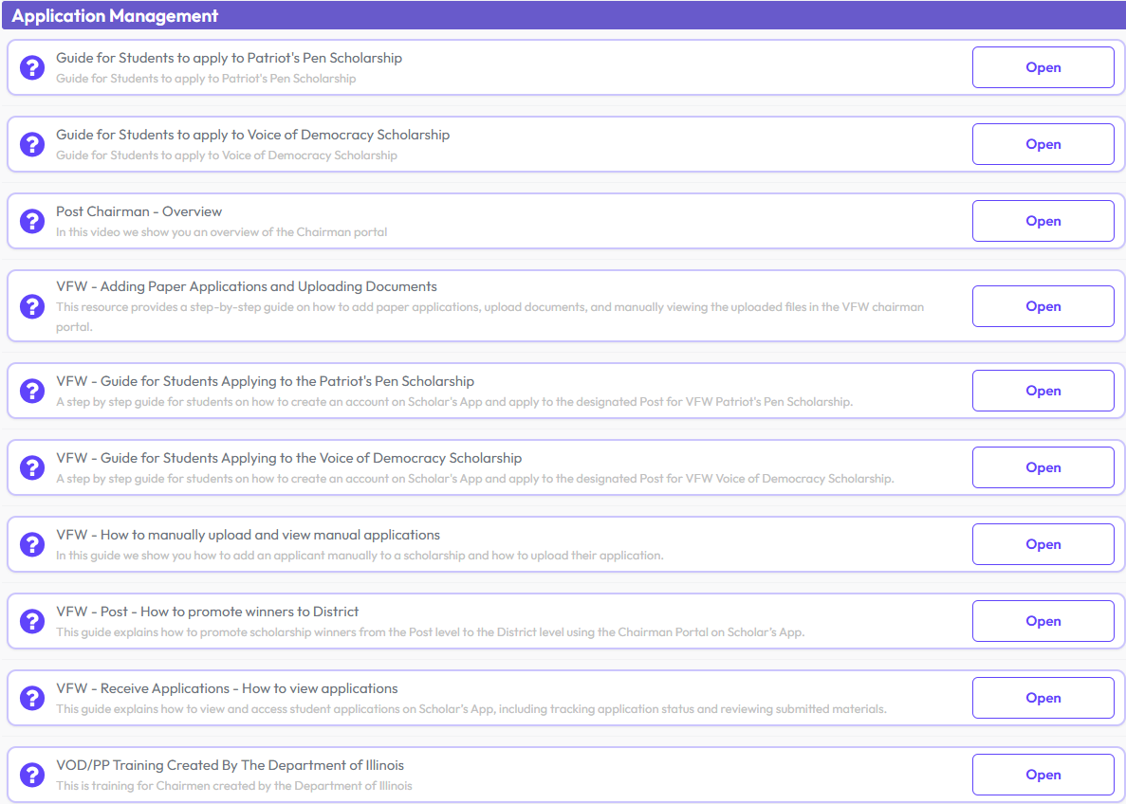

More Questions? Consult Help Center Tab

Slide 21
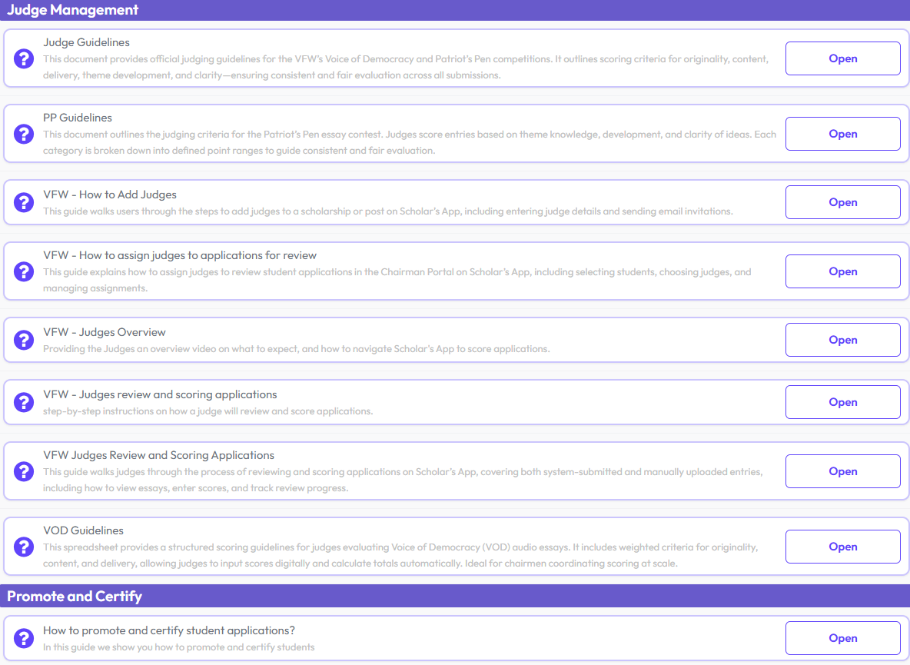
More Questions? Consult Help Center Tab

Slide 22
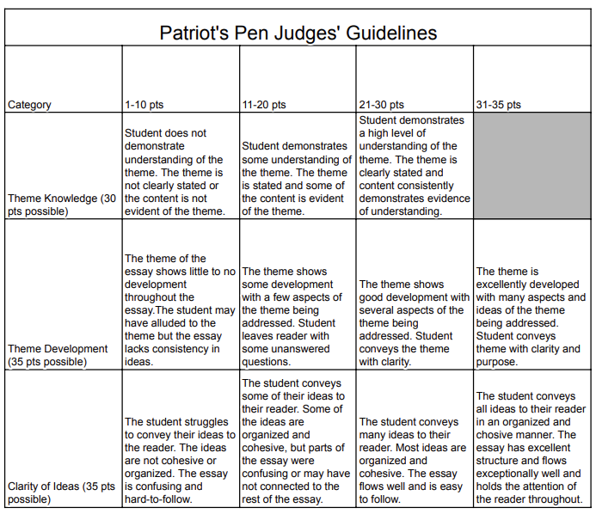

Slide 23
